Slide 1
CONSIGNMENT ACCOUNTS
DR. RAJ ANKUSH SOSHTE
ASSOCIATE PROFESSOR ACCOUNTANCY

Slide 2
What is consignment ?

Slide 3
Distinction between consignment and sales

Slide 4
IMPORTANT TERMS
Consignor
Consignee
Account Sales
Proforma Invoice
Ordinary Commission
Del-credere commission

Slide 5
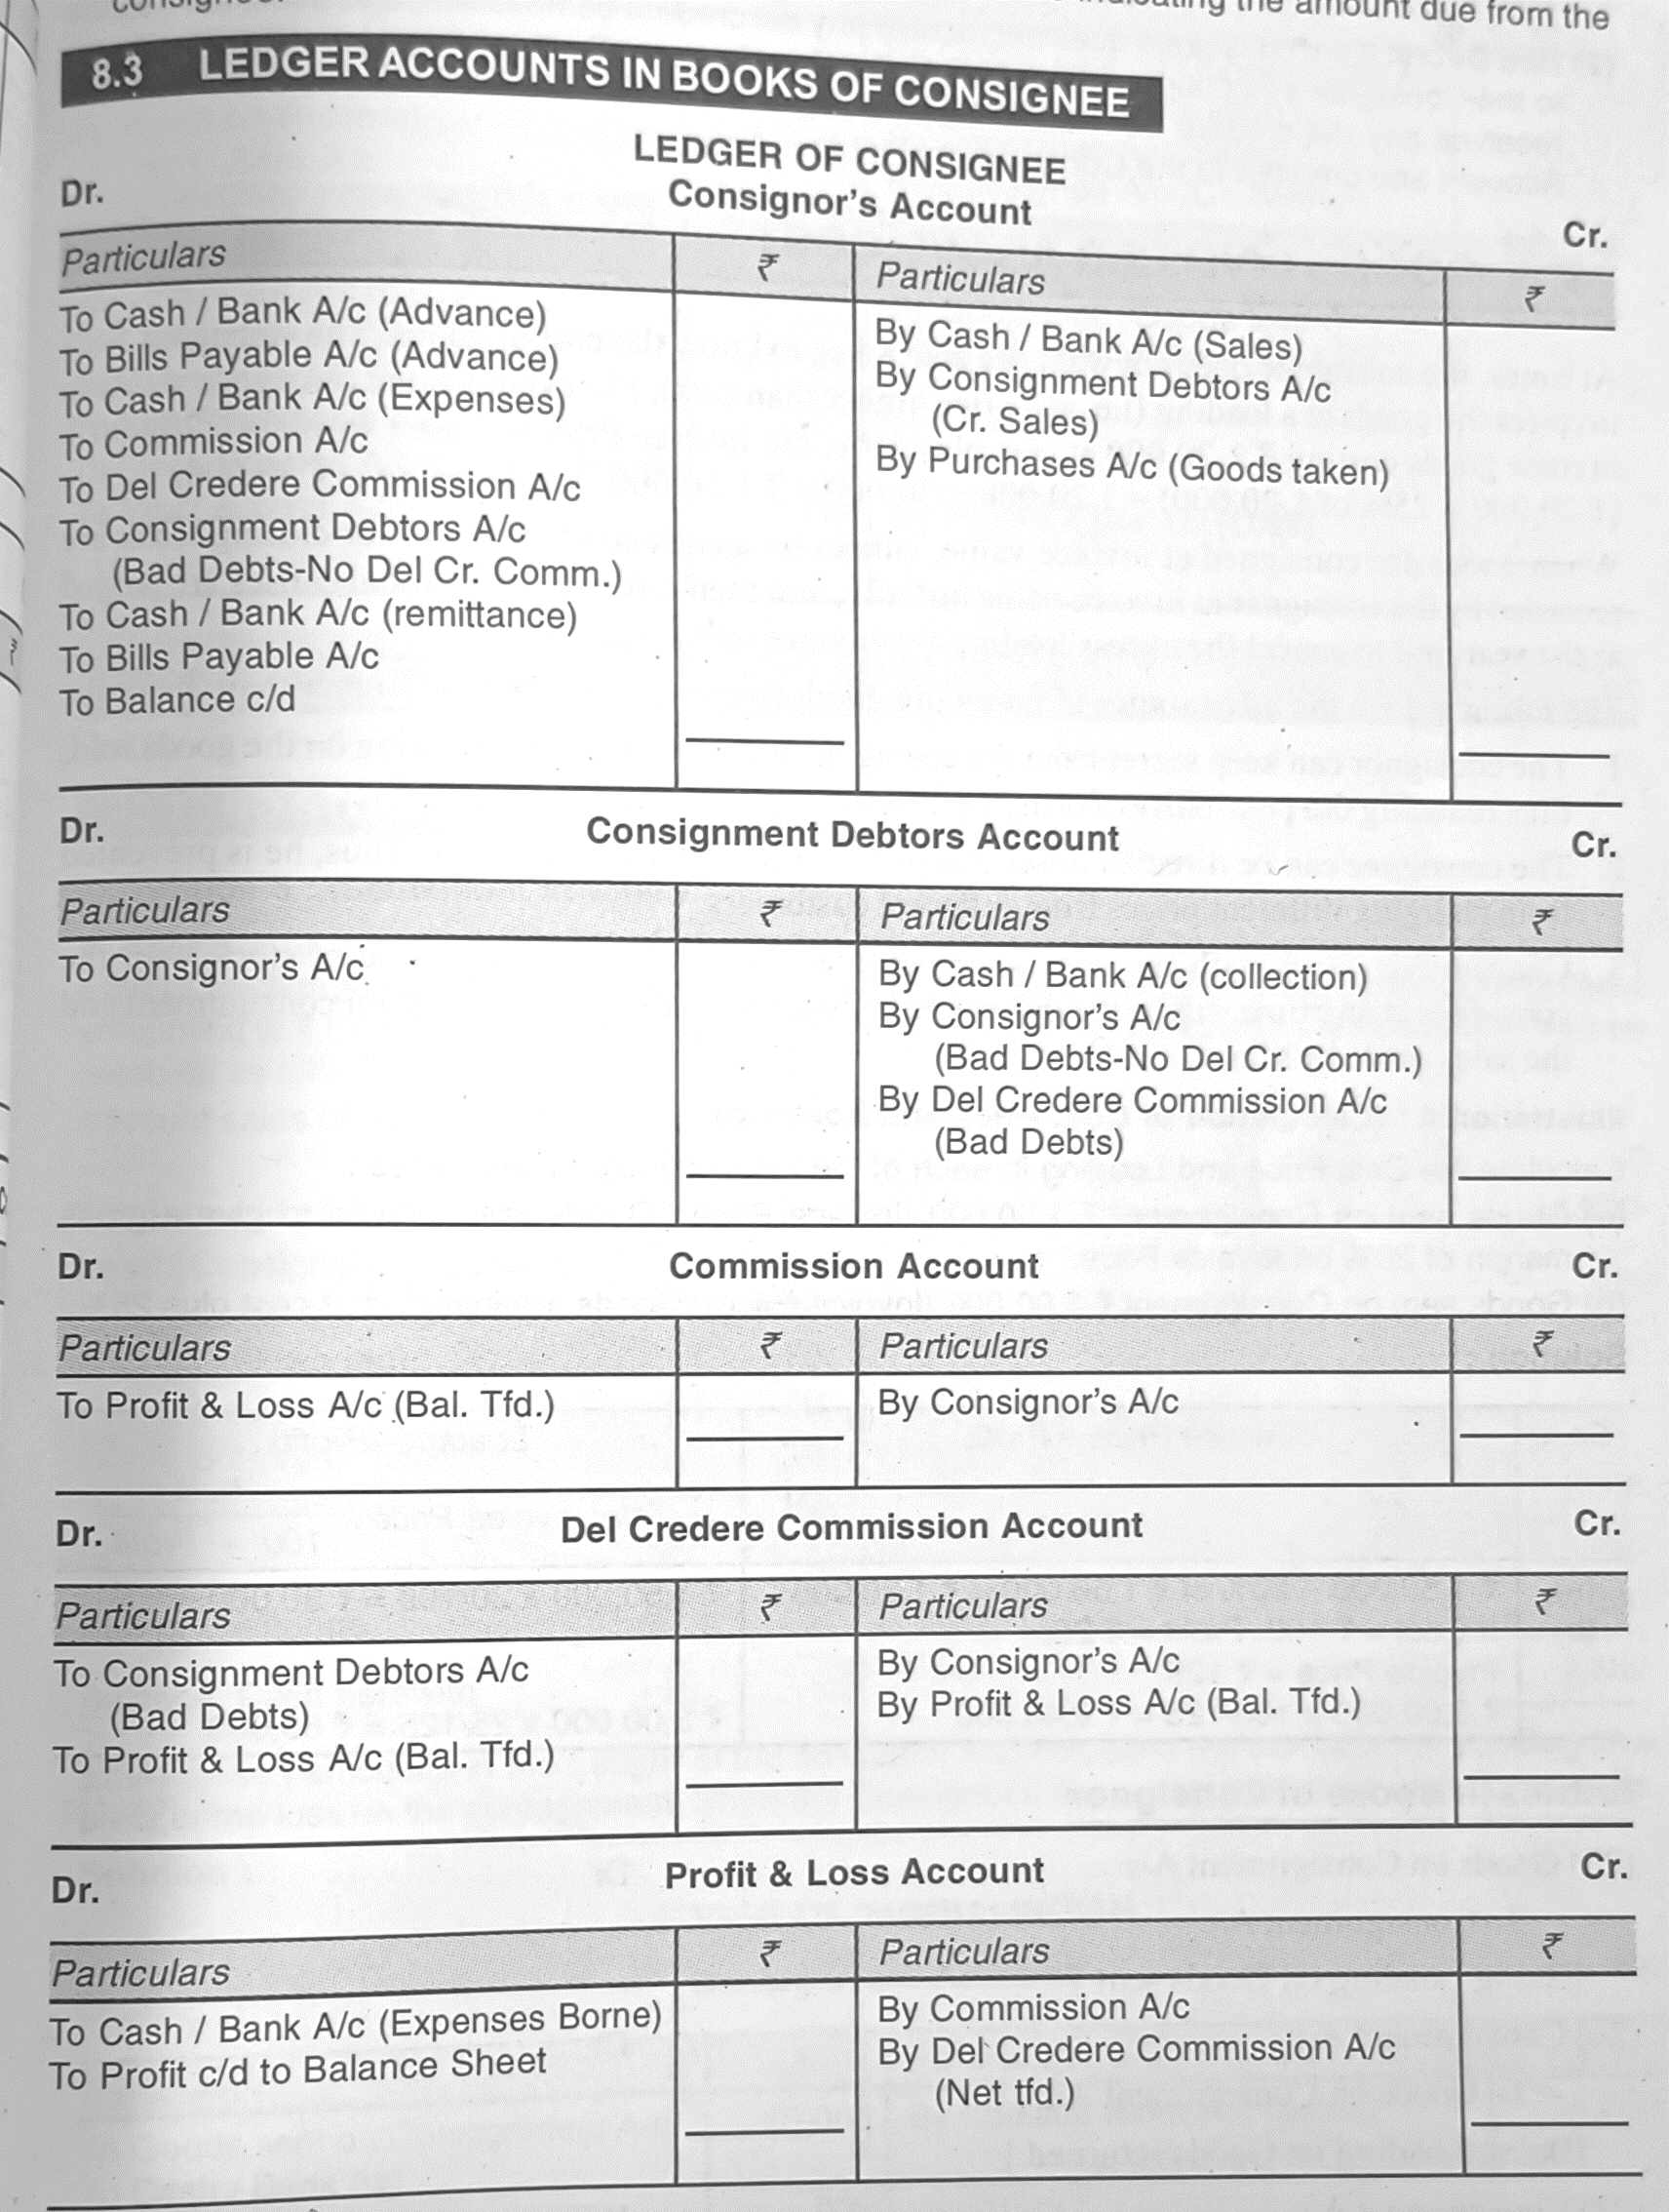
Format consignment accounts

Slide 6
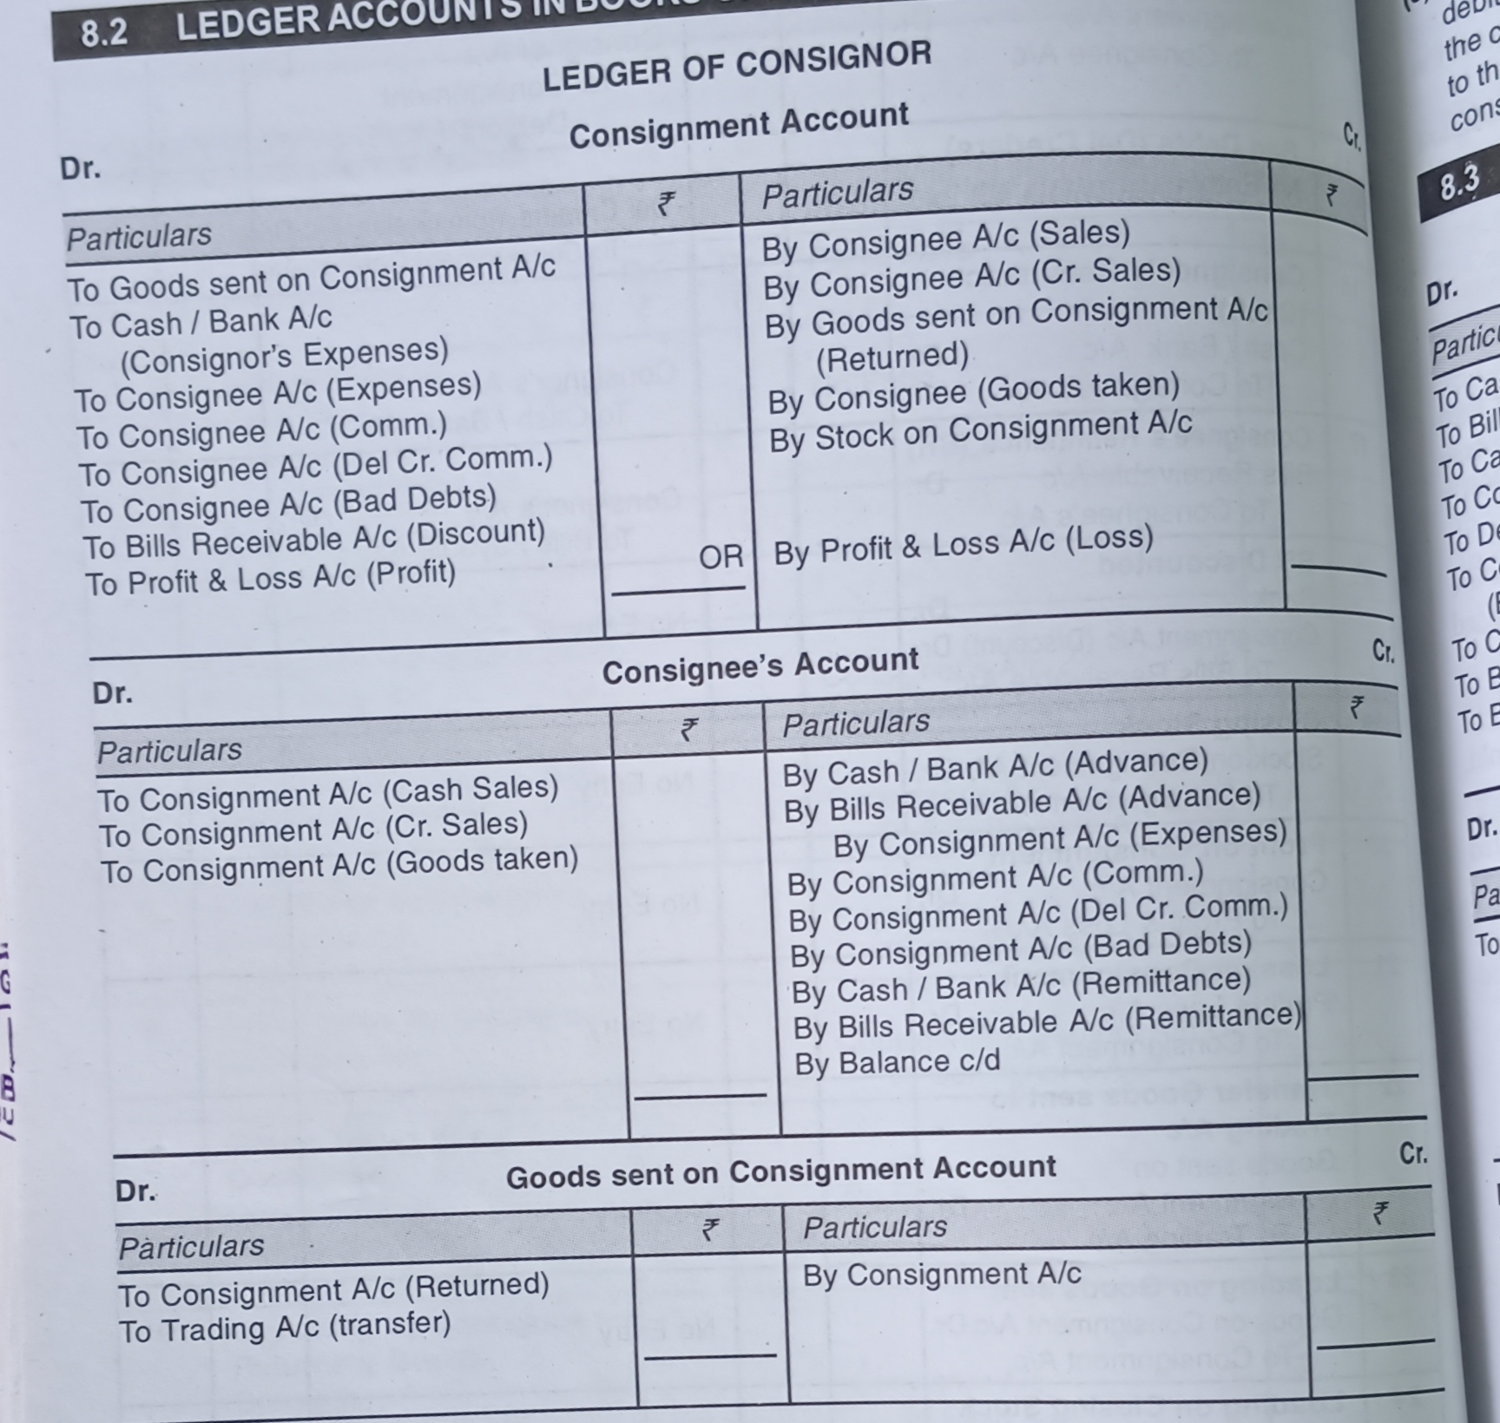
Format consignment accounts

Slide 7
Practical problems
THANK YOU

